Slide 1

Network Built of BRCKs + Blurs
Information Security and Open Internet for All

Slide 2

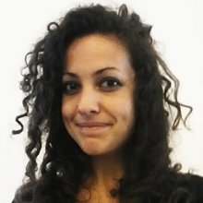
Who Are We?
Harlo Holmes
NYTimes + Guardian Project
@harlo
Aurelia Moser
Ushahidi + Internews KE
@auremoser

Slide 3
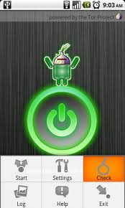




Slide 4
OPSEC for Journalists
<https://github.com/mozilla/DropItLike>

Slide 5
Haiti 2010

Slide 6
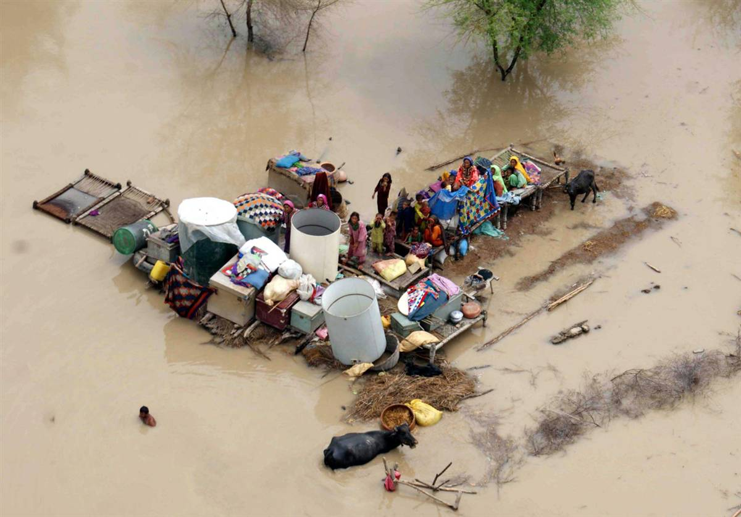
Pakistan 2010

Slide 7
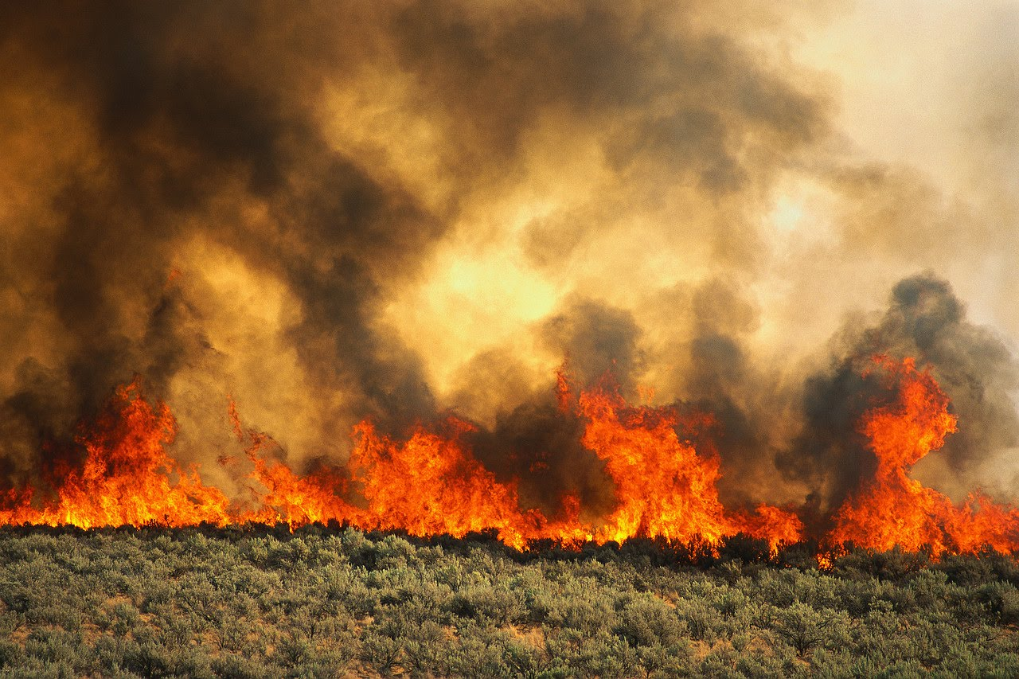
Russia 2010

Slide 8
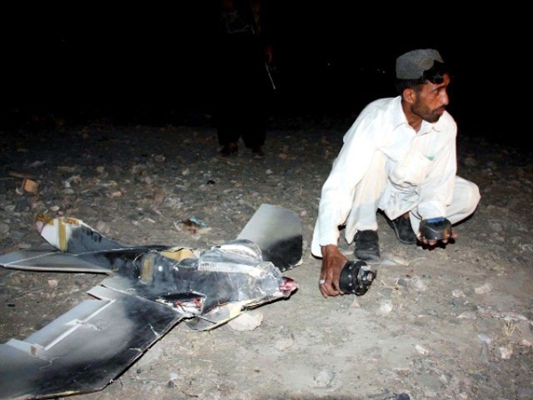
Pakistan 2011-12

Slide 9
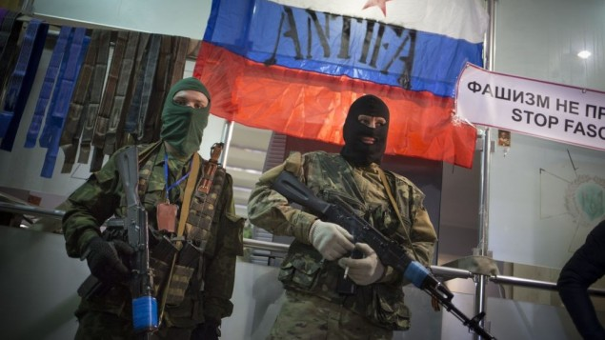
Russia 2014

Slide 10
Information security is as vulnerable to violation as physical security. Journalists straddle both vulnerabilities.

Slide 11


Slide 12
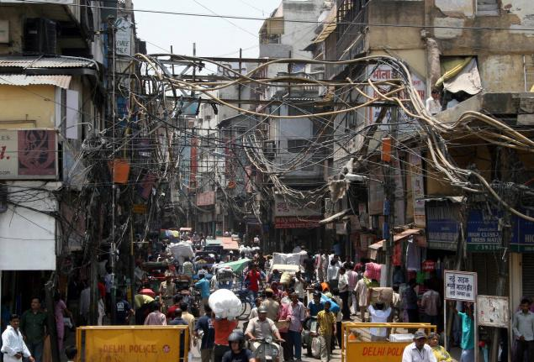
Why do we use tech designed for London and L.A. when we live in New Delhi and Nairobi?

Slide 13


In the East:
Unreliable Power
Unreliable Connectivity
Hostile Environment

Slide 14
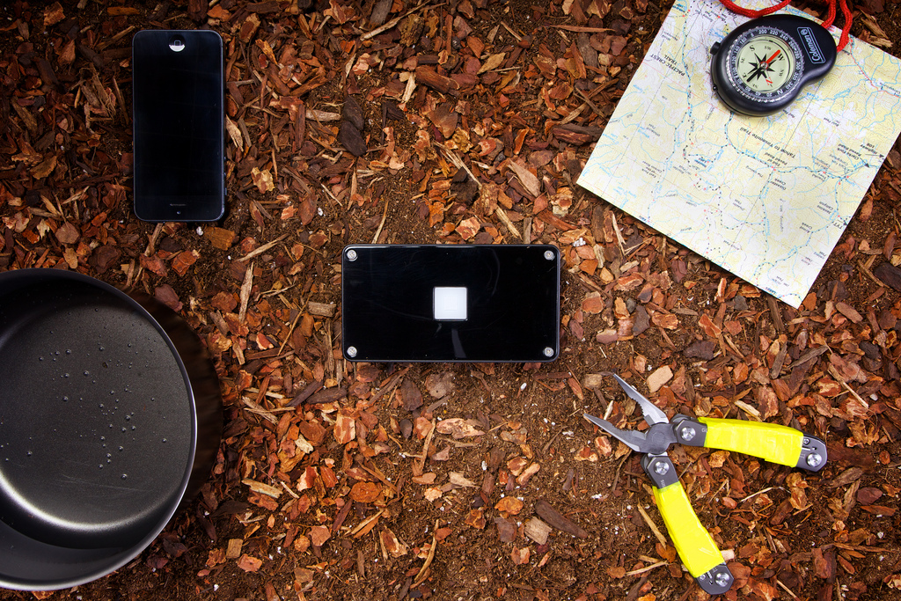

Slide 15

FEATURES
WIFI Bridge + Client Modes
WPA/PSK, WEP Encryption
3G World Modem
BATTERY
8 hr battery (full) 8 day battery (sleep)
PORTS
Ethernet LAN/WAN Port
SIM Card Slot
USB Host Port
RP-SMA Antenna Connection : 3G/4G
SPECS
<http://www.brck.com/specification/>
Cloud-managed, full-featured modern router with GSM cell failovers to get you connected
Notes:
Field and travel teams
Remote systems monitoring
Medium and small business networking
Support teams/schools
Personal networking

Slide 16
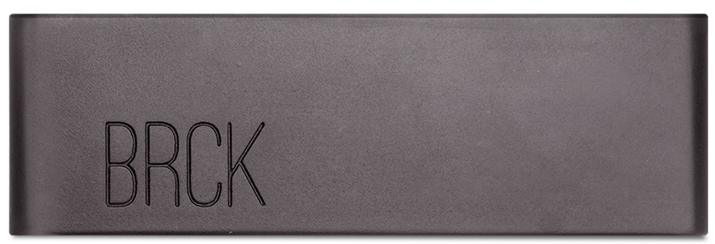

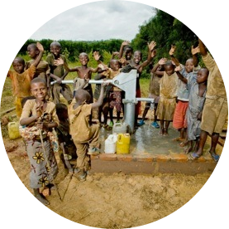
Notes:
Connecting people
Connecting sensors

Slide 17
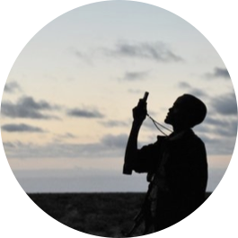


375K Rural Communities
800 M People
In Africa alone…

Slide 18


Slide 19
What is Keyblur?

Slide 20
Features

Slide 21
Applications

Slide 23
Features

Slide 24
Applications

